Slide 1

Measuring and Improving the Quality of TB Care in India Lessons from the QuTUB Project
3 November 2019

Slide 2
A massive project with many partners
BMGF India
MLE
Consulting / Data
PPIA
Qutub
Mumbai:
PATH
MJK, Alert India
Patna:
World Health Partners
Pathways
E&Y
Operations modelling
Dimagi
Transmission & CE modeling
Intellecap
State/City Govts:
Bihar Municipal Corporation
Municipal Corporation of Greater Mumbai
Drug surveillance

Slide 3
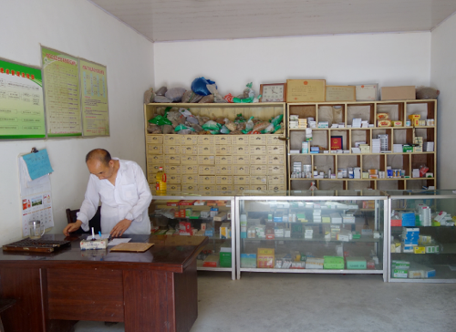
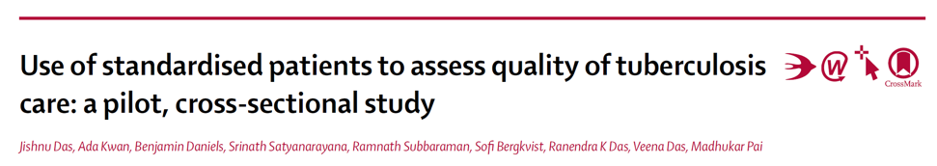

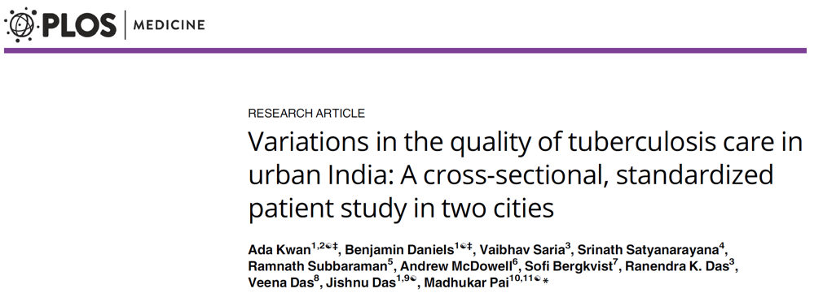
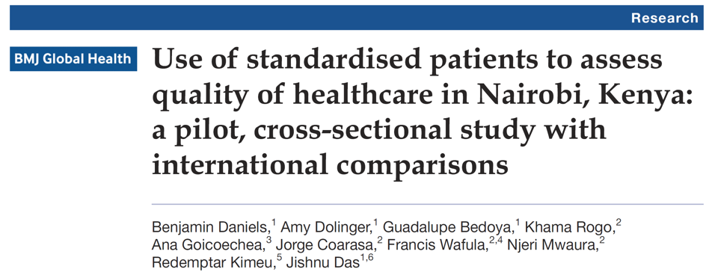
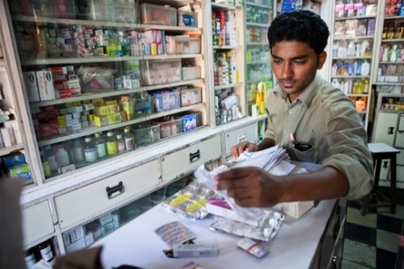
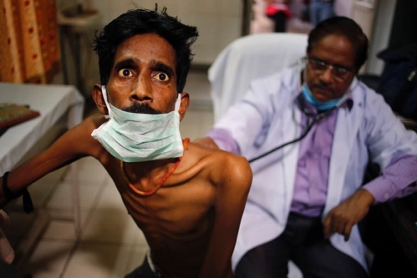

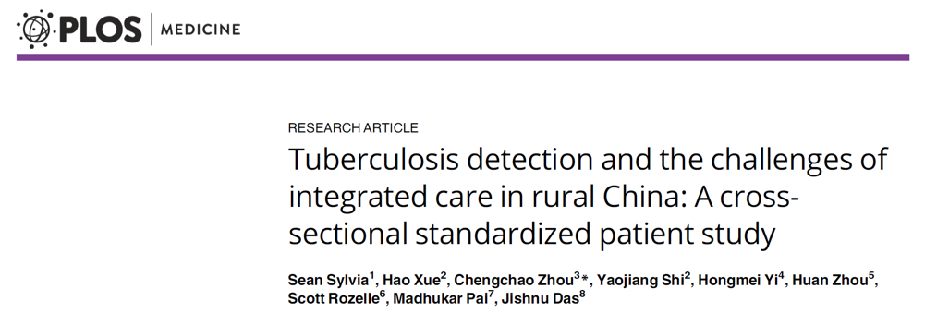
Simulated patient (SP) studies on TB:
Now used in 6 countries

Slide 4
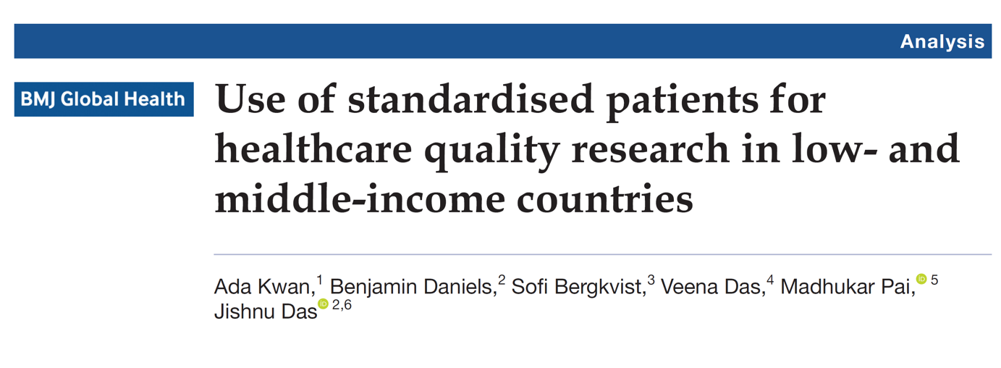
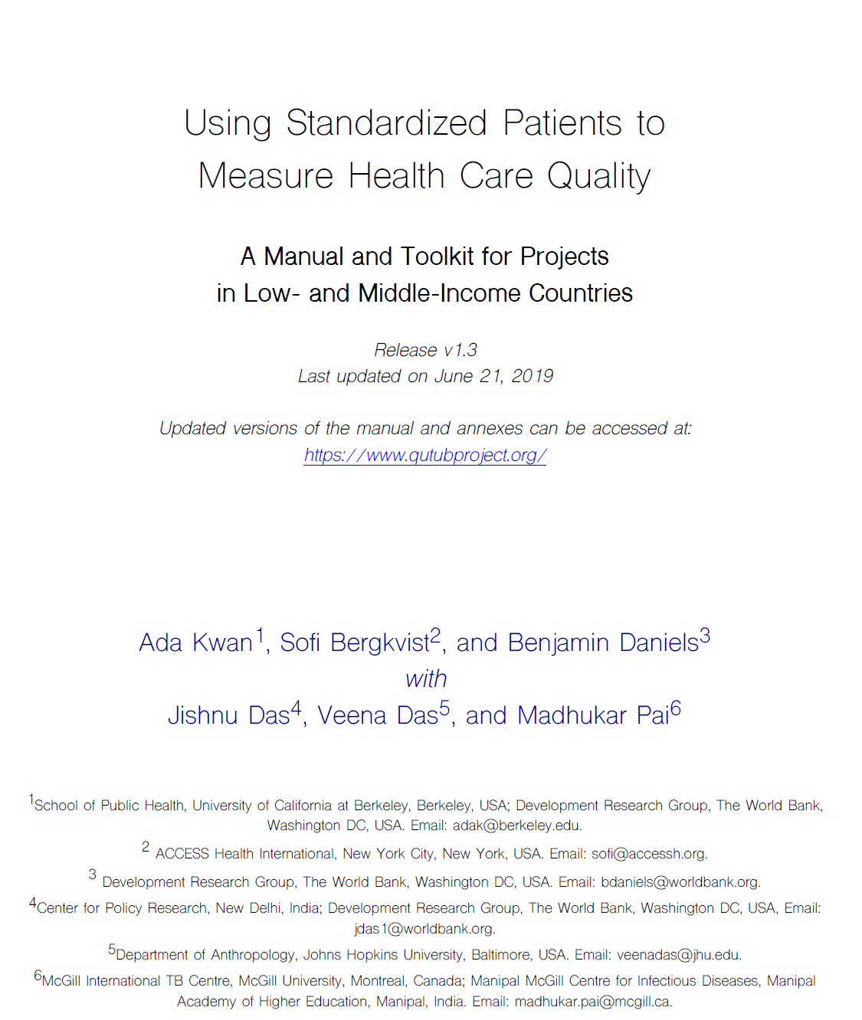
We recently published a 250-page field manual on how to conduct SP studies

Slide 5

TB care across four countries (SP data)
Low use of TB testing in most settings
High medication use in most settings
Most common TB test is a chest X-ray
Some evidence for higher quality in public sector
QuTUB Baseline

Slide 6

Globally: Wide variety of unnecessary and contraindicated medications
 | China County | China Township | China Village | Nairobi Private | Nairobi Public | South Africa PHC | Mumbai Ayush | Mumbai Hospital | Patna Formal | Patna Informal
None | 15 (71%) | 75 (36%) | 22 (31%) |  |  | 132 (92%) | 13 (3%) | 49 (16%) | 43 (11%) | 10 (5%)
Antibiotics | 1 (5%) | 15 (7%) | 5 (7%) |  |  | 11 (8%) | 2 (<1%) | 76 (25%) | 80 (21%) | 14 (8%)
Quinolones |  |  |  |  |  |  | 1 (<1%) | 4 (1%) | 13 (3%) | 3 (2%)
Steroids |  |  |  |  |  |  |  | 5 (2%) | 3 (1%)
Unlabelled | 3 (14%) | 13 (6%) | 18 (25%) | 13 (46%) | 6 (43%) |  | 226 (45%) | 33 (11%) | 13 (3%) | 73 (40%)
Antibiotics + Quinolones |  |  |  |  |  |  |  | 1 (<1%) | 8 (2%) | 1 (1%)
Antibiotics + Steroids |  | 1 (<1%) |  |  |  |  |  | 28 (9%) | 63 (16%) | 11 (6%)
Antibiotics + Unlabelled | 2 (10%) | 85 (41%) | 25 (35%) | 13 (46%) | 8 (57%) |  | 143 (29%) | 67 (22%) | 62 (16%) | 23 (13%)
Quinolones + Steroids |  | 1 (<1%) |  |  |  |  |  | 4 (1%) | 18 (5%) | 3 (2%)
Quinolones + Unlabelled |  | 3 (1%) | 1 (1%) | 1 (4%) |  |  | 15 (3%) | 6 (2%) | 18 (5%) | 7 (4%)
Steroids + Unlabelled |  | 1 (<1%) |  |  |  |  | 34 (7%) | 11 (4%) | 8 (2%) | 9 (5%)
Antibiotics + Quinolones + Steroids |  |  |  |  |  |  |  | 2 (1%) | 10 (3%)
Antibiotics + Quinolones + Unlabelled |  | 11 (5%) |  |  |  |  | 4 (1%) | 2 (1%) | 12 (3%) | 3 (2%)
Antibiotics + Steroids + Unlabelled |  | 1 (<1%) |  | 1 (4%) |  |  | 54 (11%) | 13 (4%) | 27 (7%) | 17 (9%)
Quinolones + Steroids + Unlabelled |  |  |  |  |  |  | 7 (1%) | 3 (1%) | 6 (2%) | 7 (4%)
Antibiotics + Quinolones + Steroids + Unlabelled |  | 1 (<1%) |  |  |  |  |  | 1 (<1%) | 5 (1%) | 3 (2%)
Number of Observations | 21 | 207 | 71 | 28 | 14 | 143 | 499 | 305 | 389 | 184
QuTUB Baseline

Slide 7
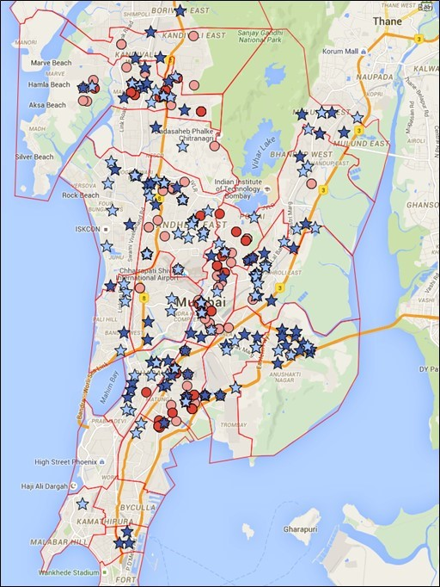
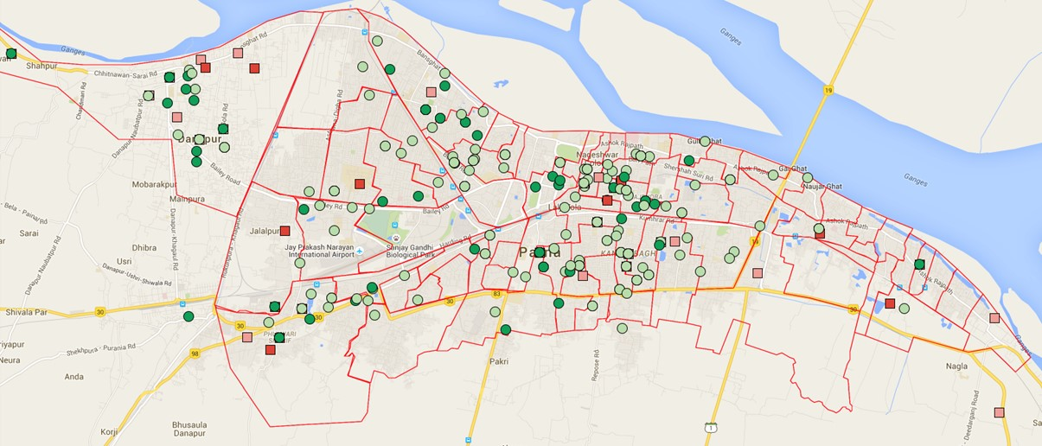
QuTUB project in India: A massive SP study used for quality surveillance
The largest SP study ever conducted
~10,000 SP interactions (so far) with health providers in private health sector
Three study rounds in each city:
Baseline (Pre-PPIA)
Endline (PPIA)
Follow-up (Post-PPIA / PPSA)
Notes:
Patna: 1,475 Formal (MBBS or Higher), 1,176 Informal (no allopathic degree)
Mumbai: 3,592 AYUSH, 1,844 hospitals, 1,709 Standalone Formal, 644 informal

Slide 8
QuTUB project in India: A massive SP study used for quality surveillance
Primary Aim: To attempt to assess whether PPIA projects improved quality of TB care.
Main takeaway 1: We can say the following with confidence:
In both cities, the program increased GeneXpert (GX) use among formal providers
In both cities, the program never has an impact on use of unnecessary medicines or other services
In Mumbai, the learning about GX due to program involvement improves GX use, but once providers have learned, convenience services from the program do not matter for doctors
In Mumbai, the program did not have any effect on AYUSH providers
Main takeaway 2: Despite the largest and most comprehensive SP study ever – ground complications, intervention design, and poor data management strategies limit our ability to draw definitive conclusions.
Main takeaway 3: The parameters that we are seeking to identify are key inputs into any modelling exercise. Given the problems in #1, they cannot be clearly pinpointed right now. If we are to say something more definitive in the future, we need to learn from this attempt and make several changes that we discuss.

Slide 9
Calculating the effects of PPIAs
Any changes that we observe in provider behavior is due to a combination of three things:
General environment – Any new tool or approach has an adoption curve that it will follow even in the absence of intervention
Overall program learning – CMEs, Field Officer visits, discussions, and services like free GX all gave engaged providers a better opportunity to learn to use the tools
Program convenience services – Staff stationed in clinic, sputum collection, vouchers, etc. lead providers to change their behavior due to access to services
The causal effect of the program is (2) + (3). For budgetary reasons, it is important to separate how much is (2) and how much is (3).
In Patna, we can only identify the combined effect of (2) + (3). In Mumbai we can identify (2) initially and (3) after learning has finished.
Identifying both of these effects requires significant human and financial resources.

Slide 10
Patna

Slide 11
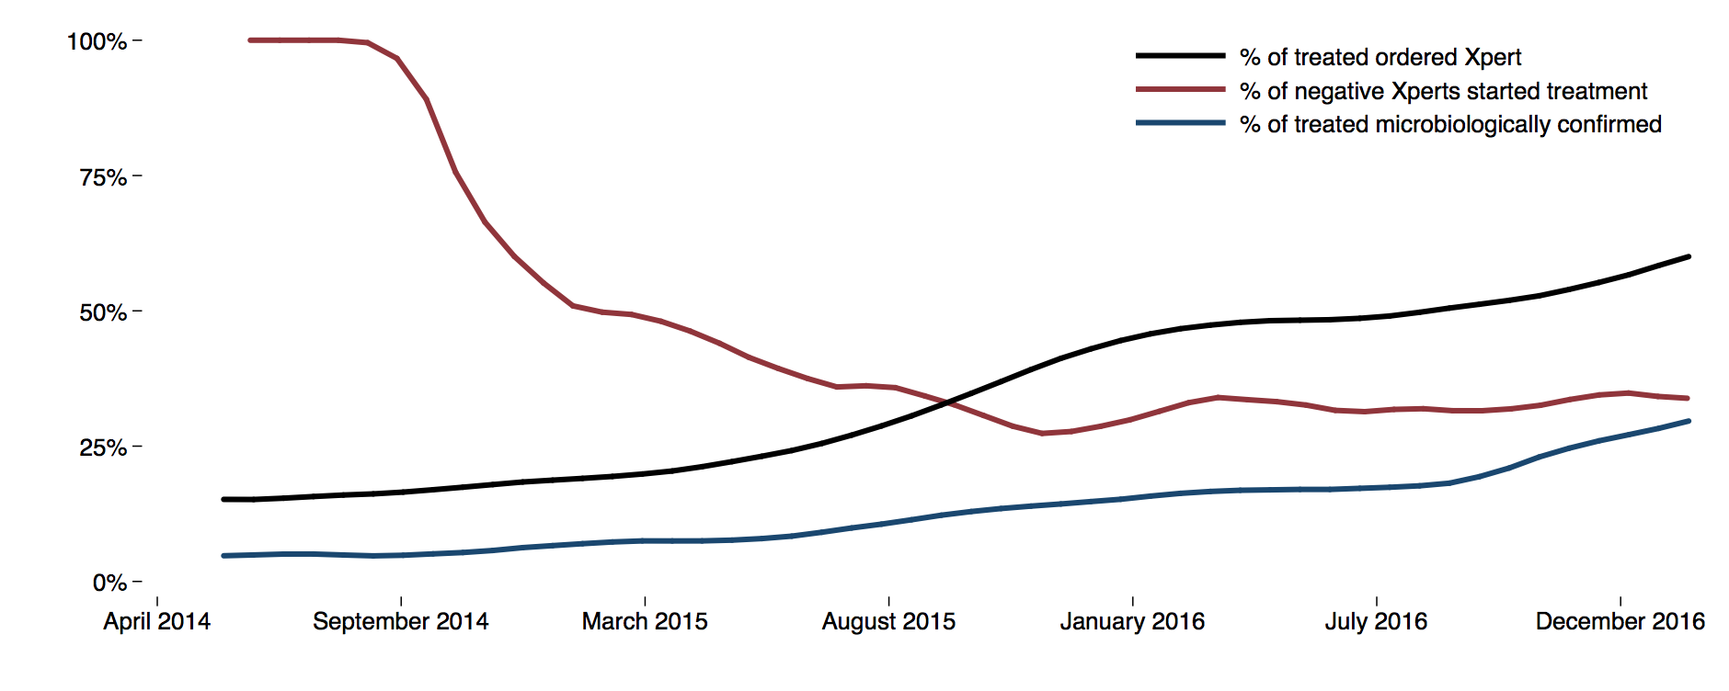
Patna: Program data suggests large effects

Slide 12
Patna & Mumbai: Use of services was low in SP study
Patna: Vouchers + financial incentives
Mumbai: Vouchers (no incentives)
Among All PPIA Providers (285 SP1, 62 SP2, 65 SP3, 69 SP4)
 |  |  |  | 97 (27%) Given |  |  |  | 259 (73%) Not Given
 |  |  |  | Chest X-Ray: 45/211 (21%) |  |  |  | 166/211 (79%)
356 Potential Vouchers
 |  |  |  | Sputum AFB: 38/123 (31%) |  |  |  | 85/123 (69%)
 |  |  |  | GeneXpert: 4/7 (57%) |  |  |  | 3/7 (43%)
 |  |  |  | TB Medication: 5/15 (33%) |  |  |  | 10/15 (67%)
 |  |  |  | 5 Given w/o Meds
Networked Hubs (172 SP1, 54 SP2, 51 SP3, 101 SP4)
 |  |  |  |  | 185 (39%) Given |  |  |  | 287 (61%) Not Given
 | 472 Potential Vouchers |  |  |  | Chest X-Ray: 82/301 (27%) |  |  |  | 219/301 (73%)
 |  |  |  |  | GeneXpert: 61/107 (57%) |  |  |  | 46/107 (43%)
 |  |  |  |  | TB Medication: 39/64 (61%) |  |  |  | 25/64 (39%)
 |  |  |  |  | 2 Given w/o Meds
Networked AYUSH (87 SP1, 21 SP2, 22 SP3, 44 SP4)
 | 44 Potential CXR Vouchers |  |  |  | 7 (16%) Given |  |  |  | 37 (84%) Not Given
Notes:
Round 1 numbers
PPIA providers conditional on making action
Not much change across rounds (not shown)

Slide 13
Therefore there are many patients not observed in program data
Key insight – program data misses two groups:
Providers who are not in the PPIA
Patients who PPIA providers do not register
Therefore:
No direct way to tell how much PPIA behavior change is “general”, or growth in utilization of GX that would have happened anyway
No way to tell how much change in a given provider reflects selective reporting within PPIA, such as learning to only register patients for whom they order GX
SP data addresses these questions by observing providers outside the PPIA, and providers within the PPIA regardless of reporting the patient

Slide 14
Patna: Evaluation Strategies
We have to compare the behavior of providers who are engaged in the program and those who are not. The problem is that providers who choose to engage in the program may be very different from those who choose not to. We use the following strategies:
“Differences-in-differences” – We can compare the progress over time of four separate groups: (1) providers who never joined the PPIA; (2) providers who were in the PPIA from the beginning; (3) providers who joined the PPIA during the surveillance period; and (4) providers who left the PPIA during surveillance
Randomization – In the second year during program expansion, we worked closely with WHP to develop an RCT-style evaluation program where providers were offered PPIA engagement based on a randomized draw.
In both cases, the estimate is the excess performance gain of PPIA providers in Round 2

Slide 15
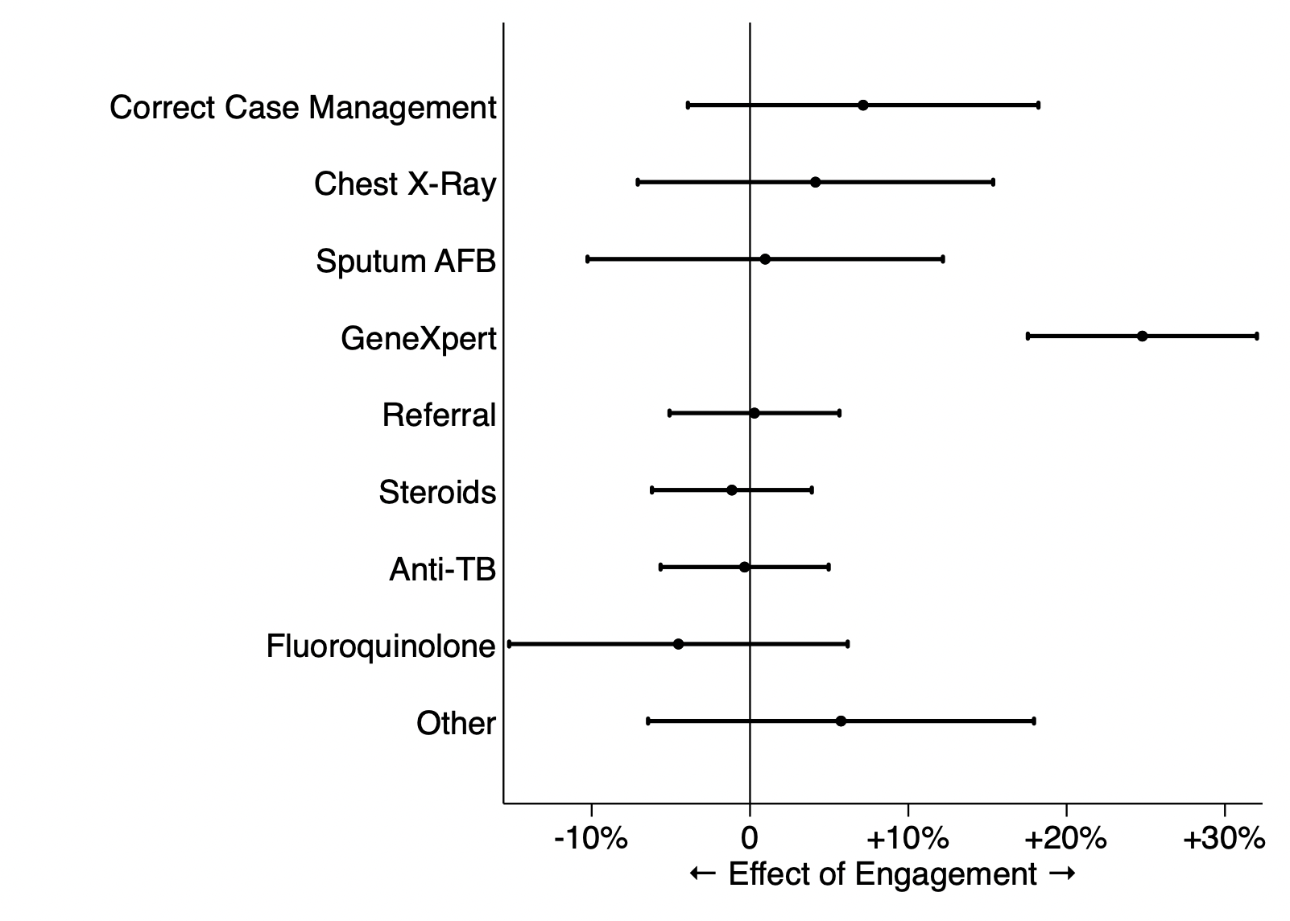
PPIA effect on formal providers: DiD
Difference-in-difference regression model estimates effect of engagement across two rounds of SP data
(Bonferroni corrected for multiple hypotheses)
Note: Don’t focus on the “correct” measure at this stage since it is sensitive to the modeling choices that are not fully worked out.

Slide 16
Randomization experiment
Enrollment: Assessment of MBBS practitioners (N=320)
Randomization into two groups and active PPIA recruitment of MBBS assigned to “Treatment”
“Control” Group:
MBBS who should not be approached by the PPIA (N=150)
“Treatment” Group:
MBBS who should be actively recruited by the PPIA (N=170)
Baseline SPs (Round 1)
Endline SPs (Round 2)
Patna: MBBS Providers who were not engaged at the end of the first SP round

Slide 17
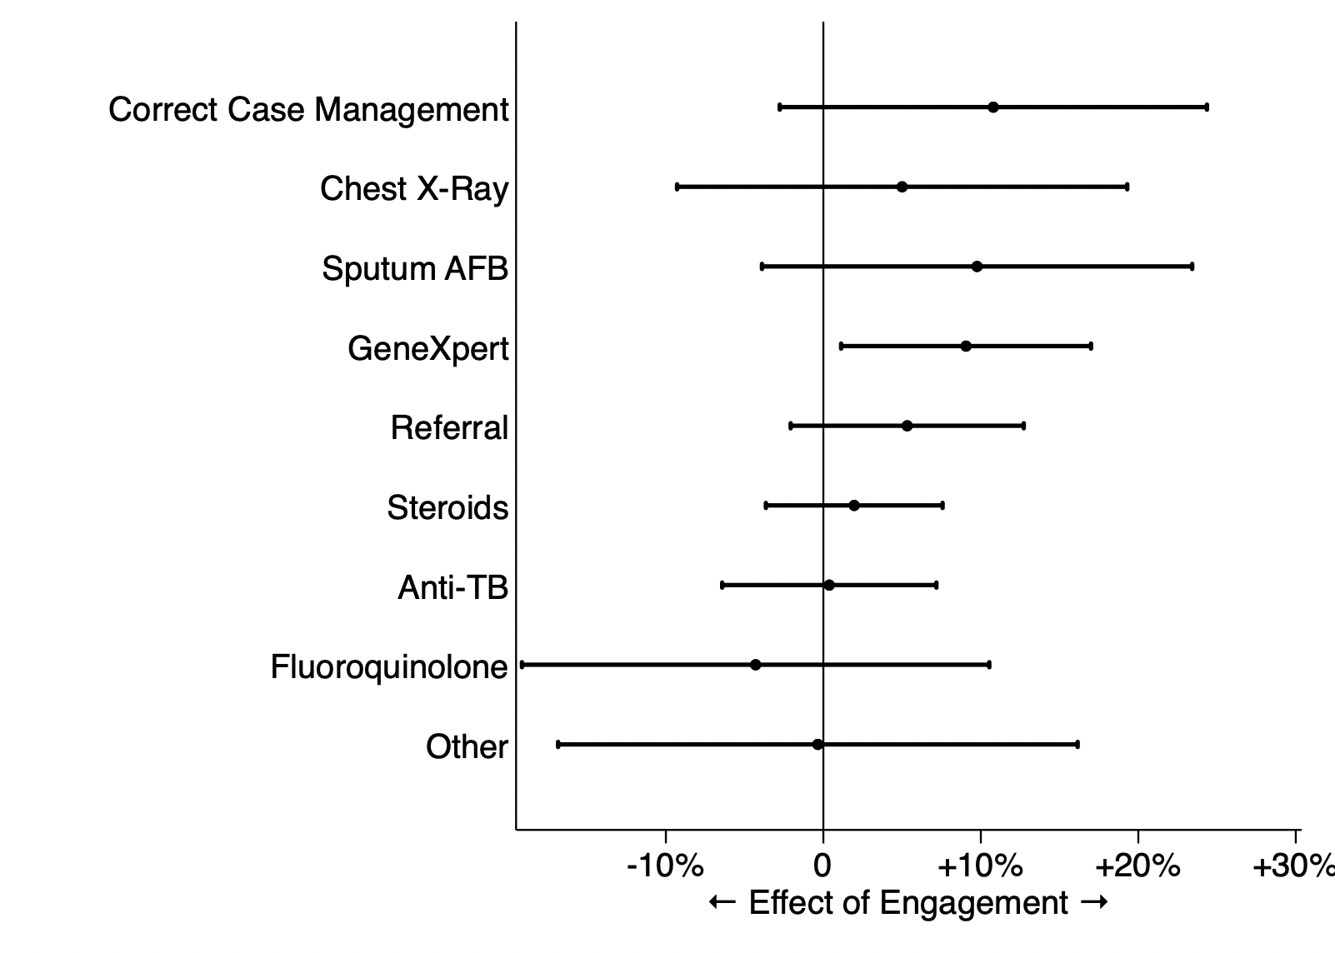
Reduced form results: effect of offering program
Effect sizes double with IV regression – this means that both strategies suggest around 20% increase in GX use from the PPIA
(Bonferroni corrected for multiple hypotheses)
Notes:
After controlling for cases and including fixed effects, estimates of the program impact show increases in:
Correct case management by at least 22 p.p. from 43%
CXR by at least 11 p.p. from 62%
Sputum AFB by at least 19 p.p. from 27%
Xpert MTB/RIF by at least 22 p.p. from 4%

Slide 18
Bounds on the possible effect
Causal impact suggests correct treatment increases ~10% and GX increases ~20%
But, this is only representative of providers who joined between the first and second year
If impacts were larger on those who joined before SP work began, they might be significantly higher

Slide 19
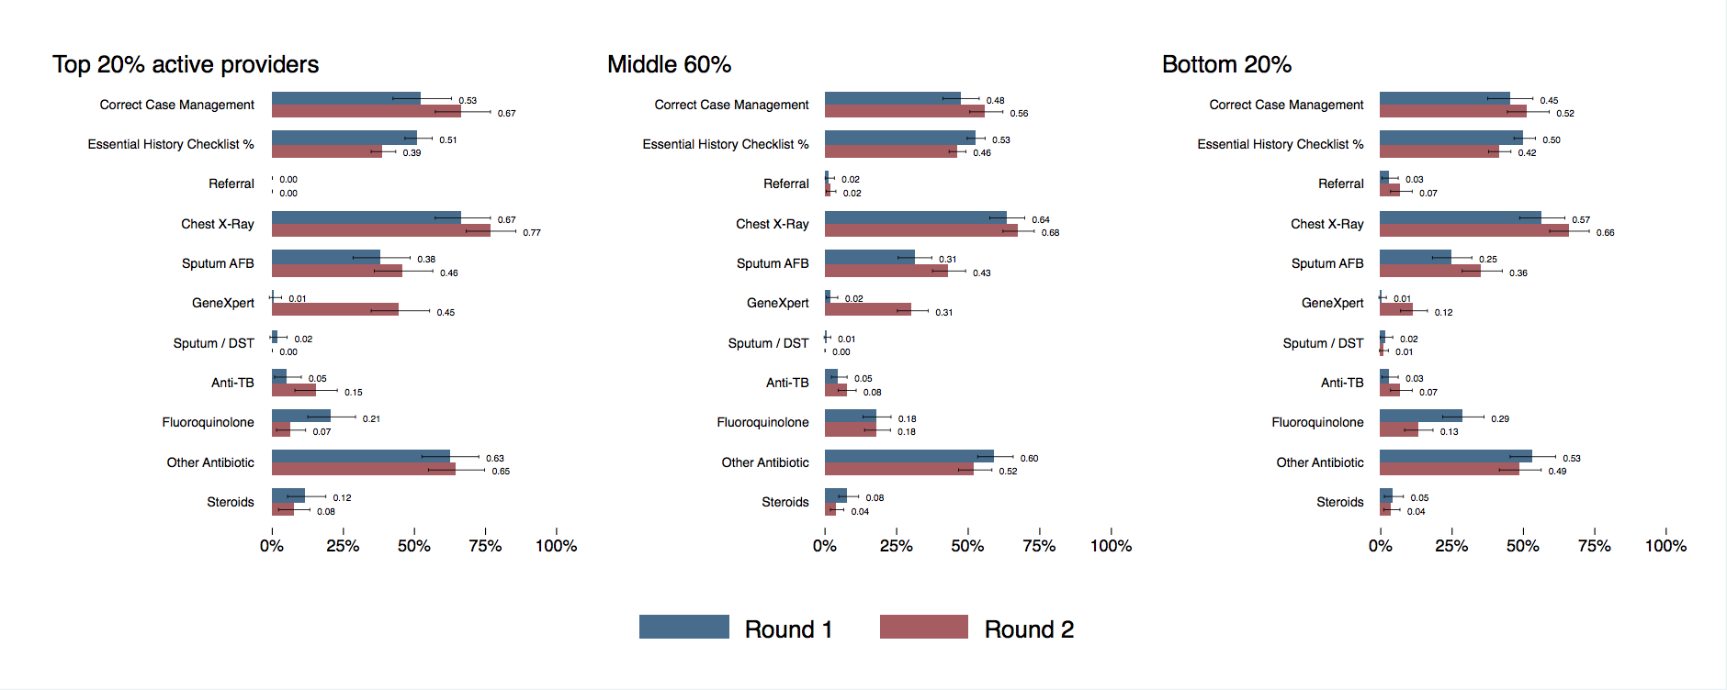
Some evidence: Differential changes by provider activity
Effects as large as +14% correct,
+45% GX
Available for DiD and randomization strategies
Always in the PPIA

Slide 20
Patna: Conclusions
There are clear time trends in the data
Despite this, we can definitively say:
The program potentially had moderate effects on correct treatment
The program increased GX use (+17-25% among those who accept engagement)
The program had no effect on unnecessary medicines
Because we cannot say anything about providers who were always engaged, these are likely a lower bound effect. The true effects may be much larger, but we cannot make this claim.

Slide 21
Mumbai

Slide 22
Mumbai: Main differences from Patna
We have randomization among AYUSH but not formal providers
Among formal providers (“hubs”), we do have very careful sampling that allows us to distinguish convenience and learning effects
From Round 2 to Round 3, we can definitively identify convenience effects and show that they are small
General messages:
No program effect on AYUSH at all
No convenience effect on formal providers at all
Potentially large and persistent learning effects for formal providers

Slide 23
AYUSH strategy: Randomization
Enrollment: Assessment of AYUSH practitioners in two wards (N=300)
Randomization into two groups and active PPIA recruitment of AYUSH assigned to “Treatment”
“Control” Group:
AYUSH who should not be approached by the PPIA (N=150)
“Treatment” Group:
AYUSH who should be actively recruited by the PPIA (N=150)
Baseline SPs
(Round 1)
Endline SPs
(Round 2)
Mumbai: AYUSH providers who were not engaged at the end of the first SP round

Slide 24
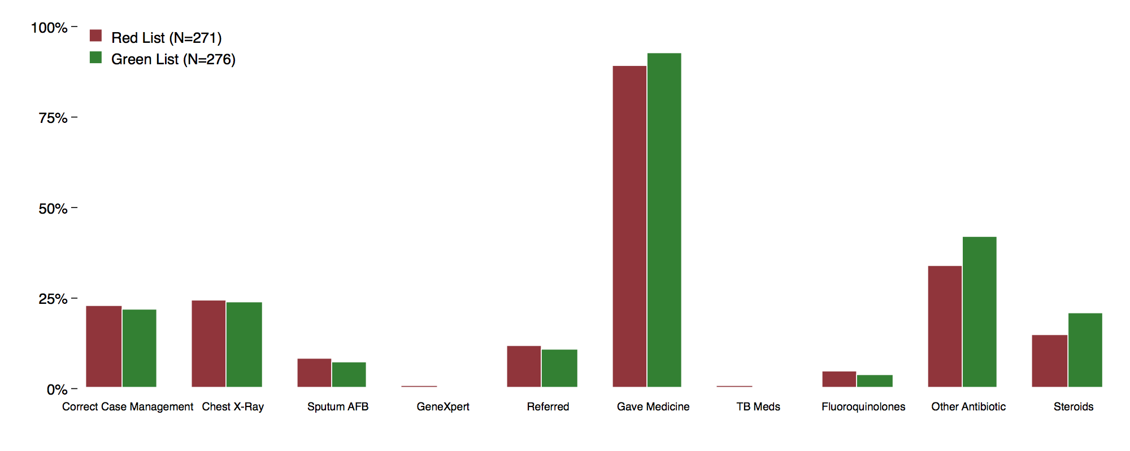
Mumbai: No effect on AYUSH behavior or referral

Slide 25
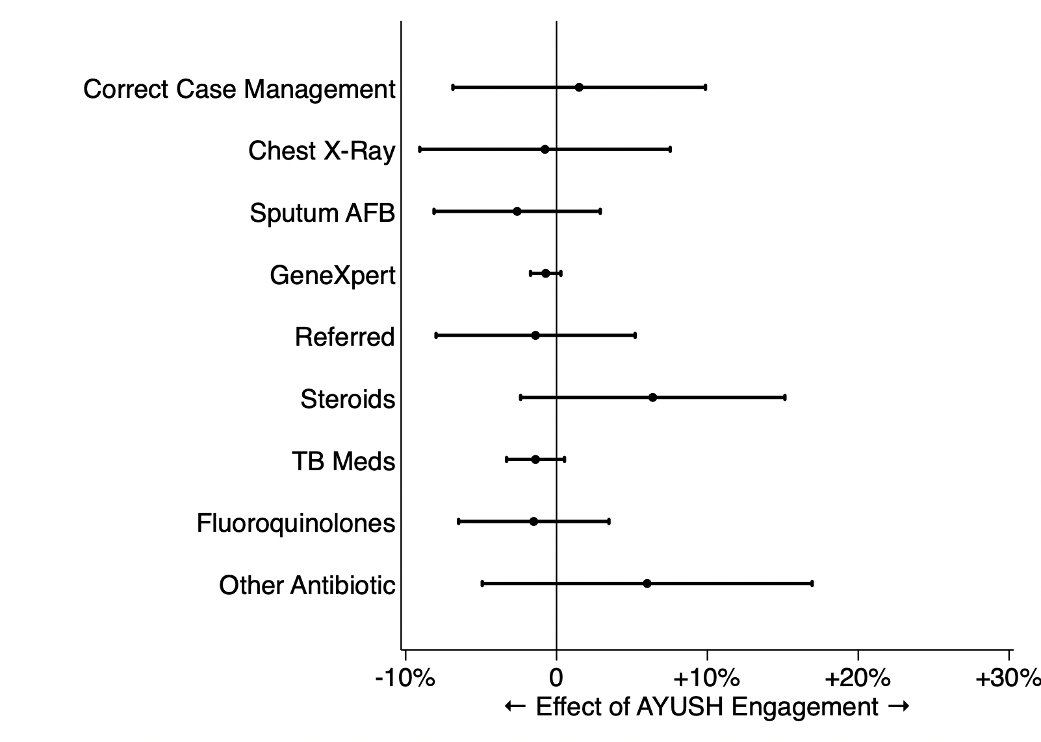
Regression model

Slide 26
Mumbai Hub Facilities (N=275)
Round 1
Round 2
Round 3
Sample 1:
Apple Hubs
Non-PPIA (63)
Non-PPIA (45)
Non-PPSA (113)
45
45
18
16
52
Sample 2:
PPIA Hubs
PPIA (98)
PPIA (146)
2
PPSA (54)
98
46
6
30
24
Sample 3:
NNL Locations
Non-PPIA (64)
Non-PPIA (34)
Non-PPSA (58)
34
34
Making this figure required one year of work! (Why?)
Sample 4:
PPSA Locations
PPSA (50)

Slide 27
Things were changing in the background
(These are facilities that never joined the PPIA)

Slide 28
Mumbai Hubs: Complex structure
R1
Green: PPIA
Red: Non-PPIA
(Note that provider and facility status do not necessarily correspond)
NNL = Non-networked Location, a PPIA provider has another non-PPIA facility
Provider Joins in R2
NNL Facility Joins in R2
R2

Slide 29
Learning effect improves GX
PPIA providers improve their GX use faster than other providers in the same facilities

Slide 30
Convenience effect of services
The same PPIA provider behaves similarly whether in a PPIA facility or a non-networked facility

Slide 31
No significant changes after Round 2
Note: Mumbai only; returning to Patna soon

Slide 32
PPSA services “experiment”
During PPSA transition, providers were ranked by number of notifications and cut off above 80% of PPIA patients
This means that providers at an arbitrary level were removed from the convenience services roster

Slide 33
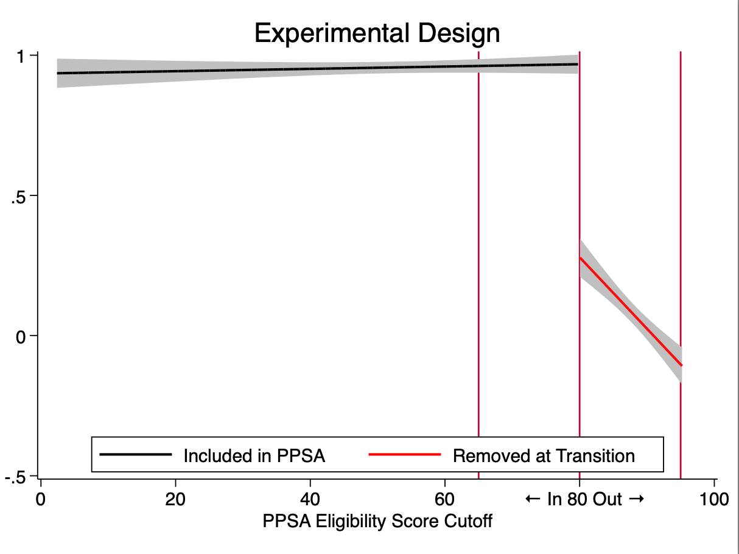
Strategy: Regression Discontinuity
Design of policy allows us to see what happens to very similar providers affected by arbitrary cutoff
Shown: probability that provider remains in PPSA after transition, by eligibility

Slide 34
No discontinuity at exclusion from PPSA
Strong indication that PPIA/PPSA services had no effect on utilization of GX
Shown: probability that provider uses GX with SPs after transition, by eligibility
Absence of
“performance gap”
implies no change in behavior
Most patients
Least patients

Slide 35
This was not easy!

Slide 36
Ground reality was highly complex
PPIAs weren’t able to wait for us to set up a full randomized controlled trial, so we had to embed attempts to get as close as possible to causally identifying an effect from the program via other activities
This started with mapping all the private providers (both inside and outside the PPIA) which was necessary both programmatically and from a research perspective
Working with the PPIA (in Mumbai) to understand that providers and facilities were independent entities and thus should have separate fields in data took several months, and was poorly reflected in central systems

Slide 37
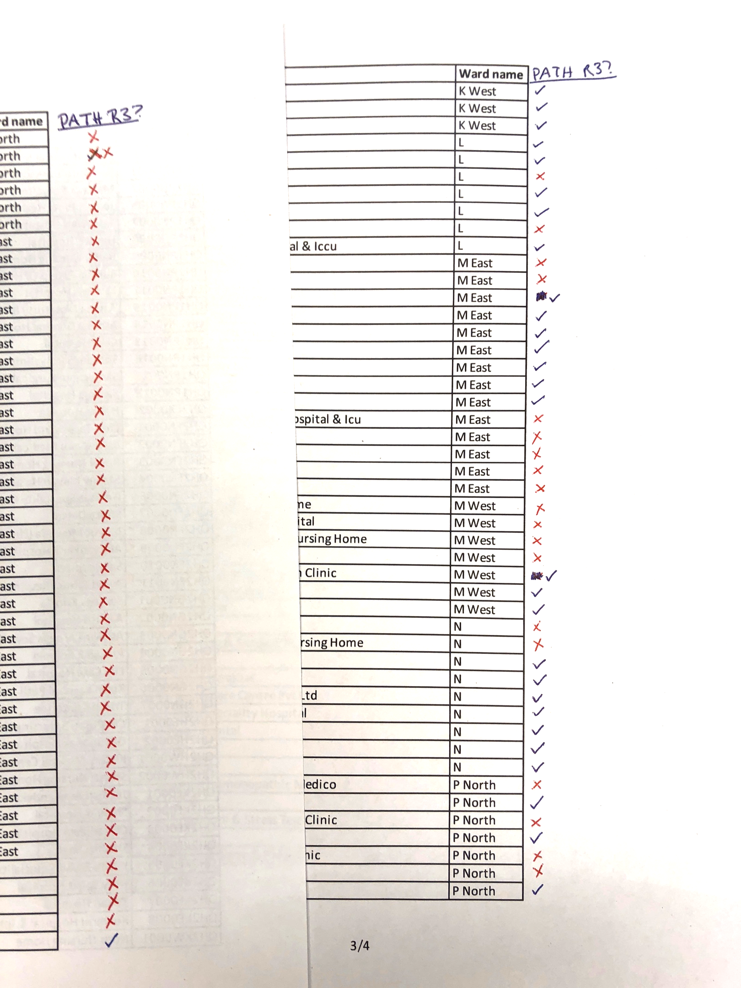
Partner organizations understand and use data with the ground reality in mind
All partner organizations did an excellent job keeping track of providers and patients in this complex landscape!
This is mostly accomplished through deep knowledge embedded in field officers and program staff
However:
What is useful information today doesn’t necessary systematize into data that can be efficient, scalable, and exploitable for other purposes
Over time, we experienced dramatic information loss:
Program staff changed and FOs left
Very hard to retain institutional memory over years
Information structure and documentation was not set up for efficient archiving and backwards searching
Keeping track of providers, provider-facilities, and patients over time was challenging

Slide 38
But, PPIA program data cannot translate well to retrospective research
Central data systems were incomplete or mapped poorly to field reality
Program data systems were jugaad-rigged on the fly
Complete mapping of providers and facilities was not fully completed
IDs and tracing of providers were weakly maintained across years
Functional addressing of facilities was rarely recorded
Follow-up of patient pathways was rarely possible

Slide 39
Central data systems were incomplete
In this program, we relied on:
PATH custom system
WHP custom system
UATBC system
Nikshay system
CommCare reports
Hand-written reports
…to name a few!
Various other systems were not delivered on time, not delivered at all, or did not function in a useful way for MLE purposes when they were delivered.

Slide 40
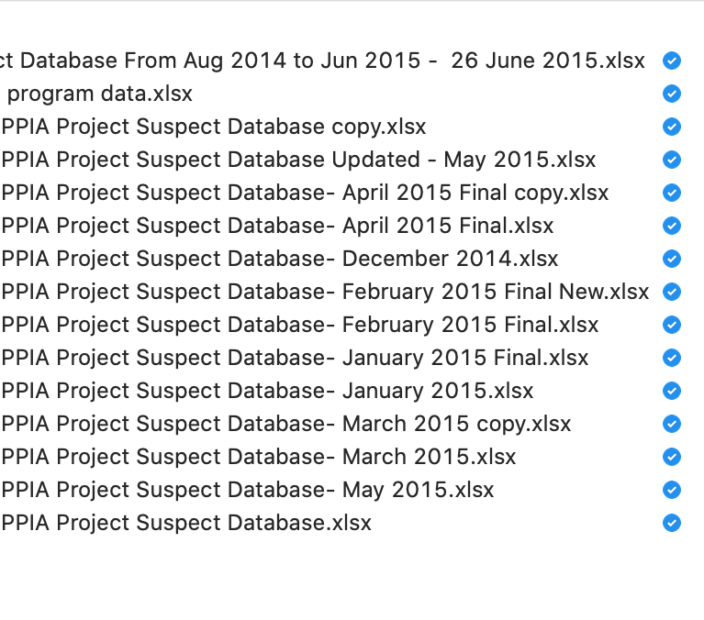
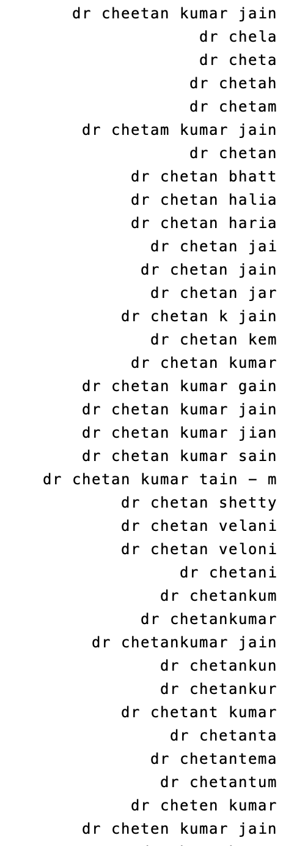
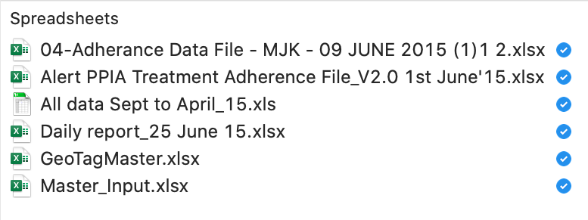
Program data systems were jugaad-rigged on the fly
All the
same
provider…
Also the same provider…

Slide 41
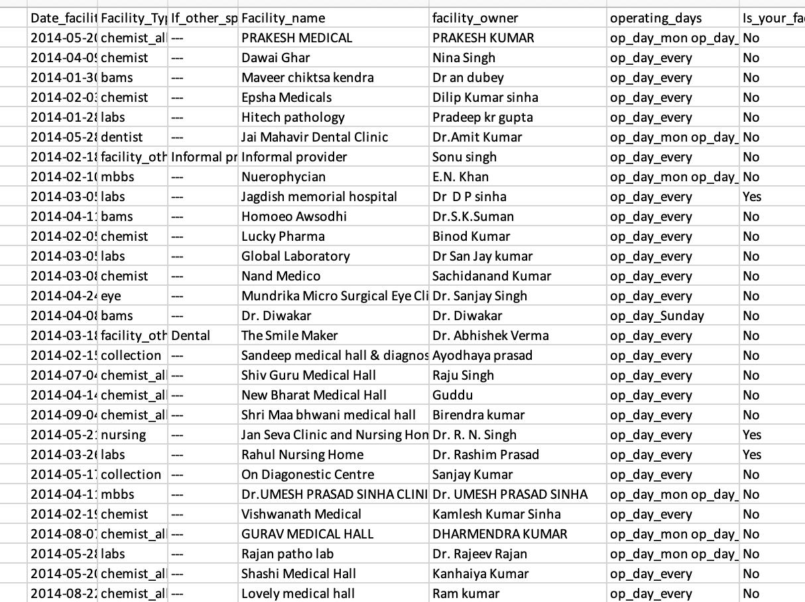
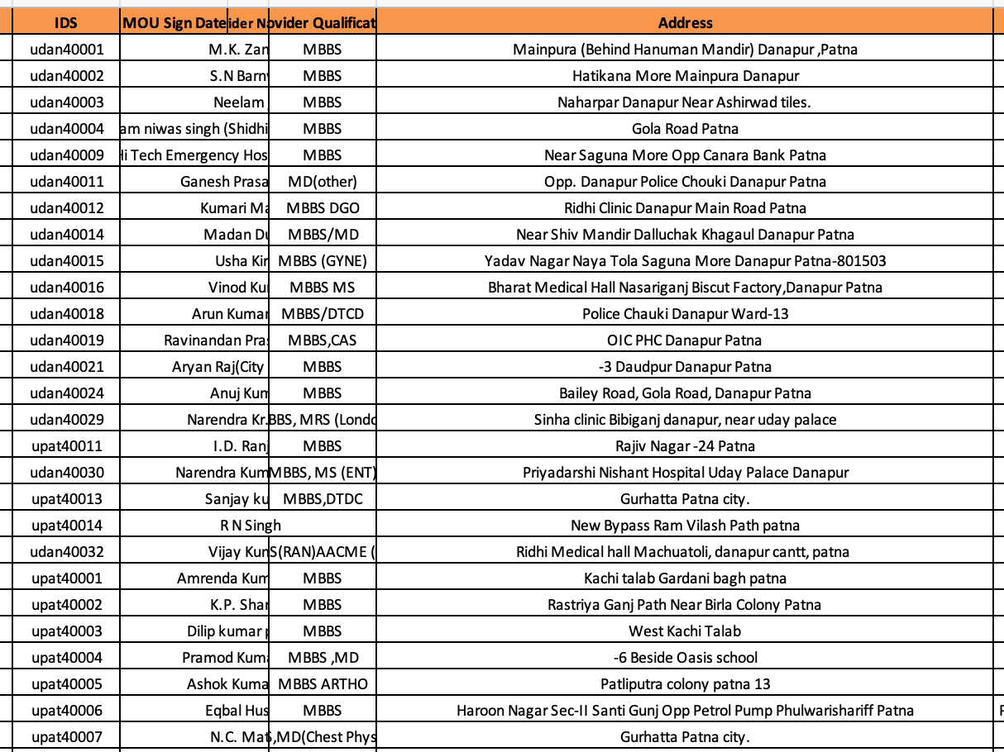
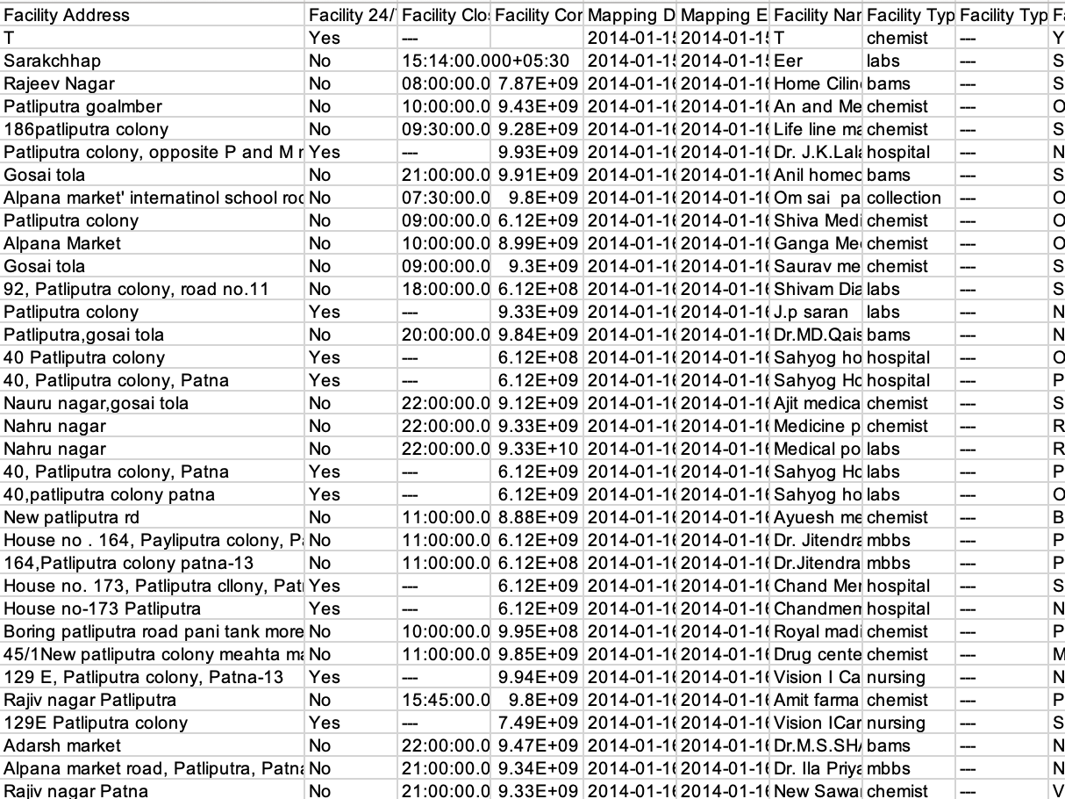
Complete mapping of providers and facilities was not fully completed
Multiple mapping rounds in both cities produced data where duplicate providers could not be resolved, and therefore there was no “master plan” possible for targeting, expansion, or comparison

Slide 42
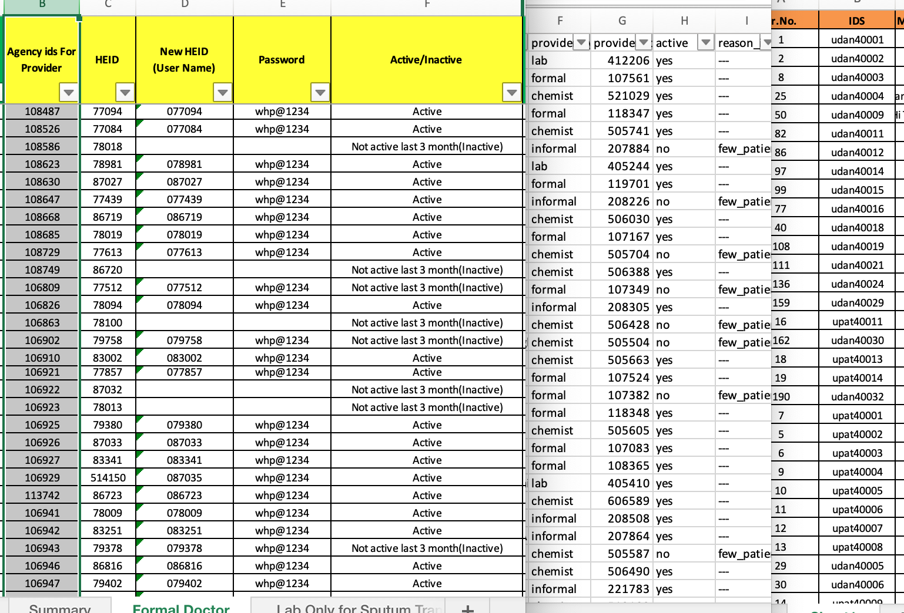
IDs and tracing of providers were weakly maintained
Multiple IDs for each provider that changed with each data system revision
Often not linked to a master database, with providers not appearing in patient list and vice versa

Slide 43
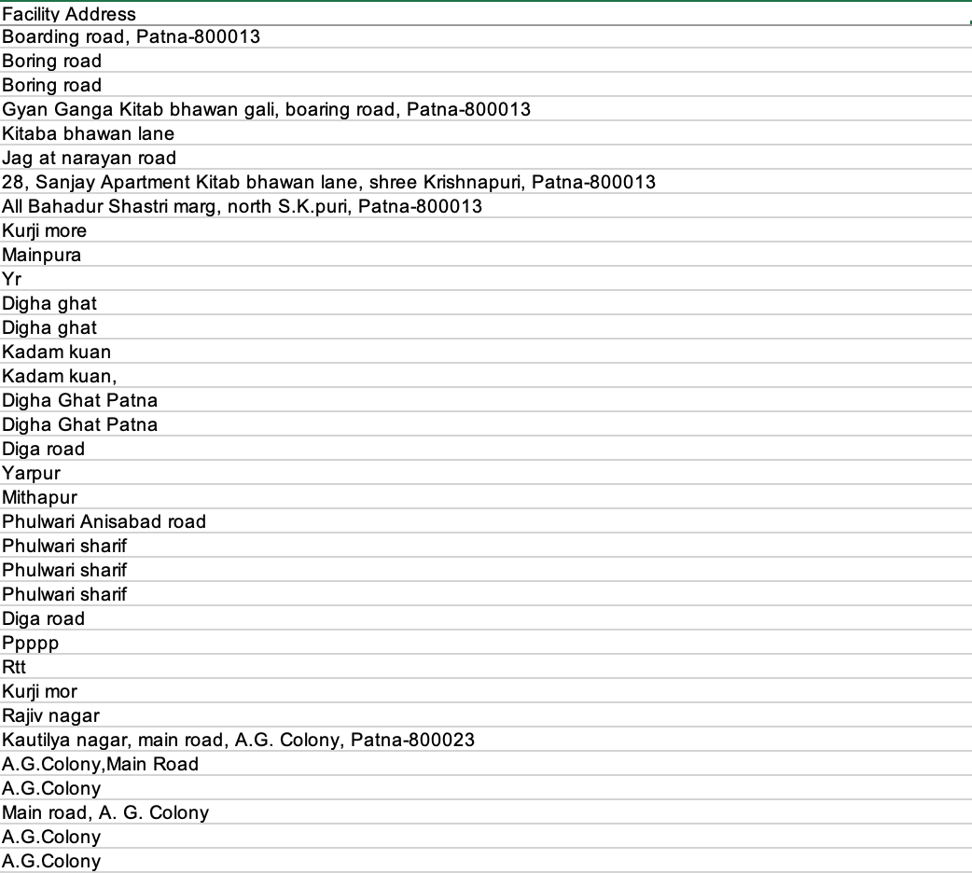
Functional addressing of facilities was rarely recorded
Remember that for us to say anything with SPs, the SPs must successfully visit specifically sampled providers and locations, with addresses that are given by us
Round 1 of Patna SPs was halted in field because the provided addresses were unusable for survey work
This was remedied in the field by a comprehensive remapping of formal providers by WHP with the support of the Qutub team, but not extended to other databases

Slide 44
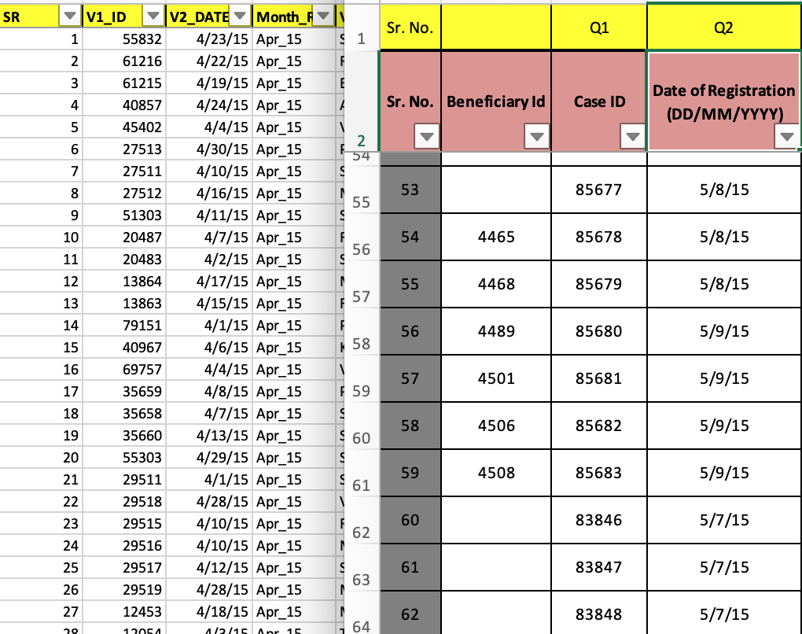
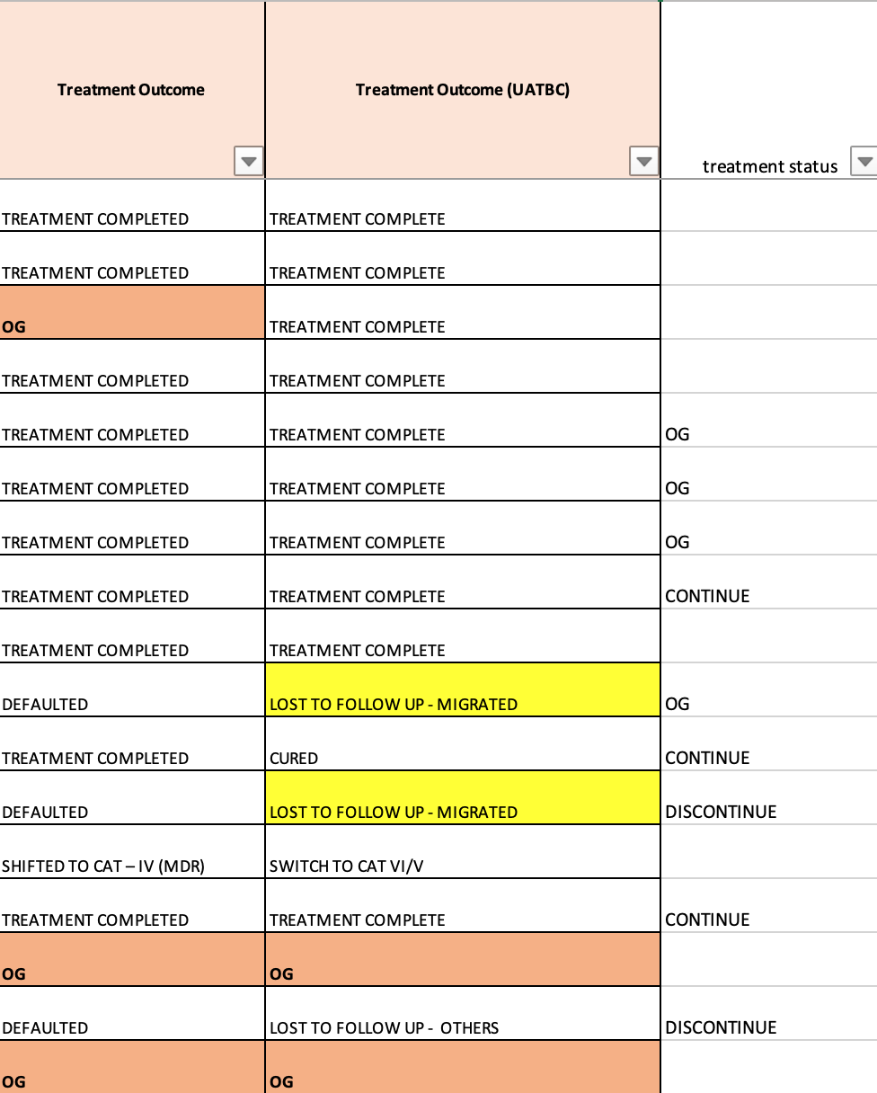
Follow-up of patient pathways was rarely possible
Patient databases similar: took multiple formats, many duplicate names, IDs changed with technical changes in program
Patients could rarely be traced on referral or throughout the treatment process in the data

Slide 45
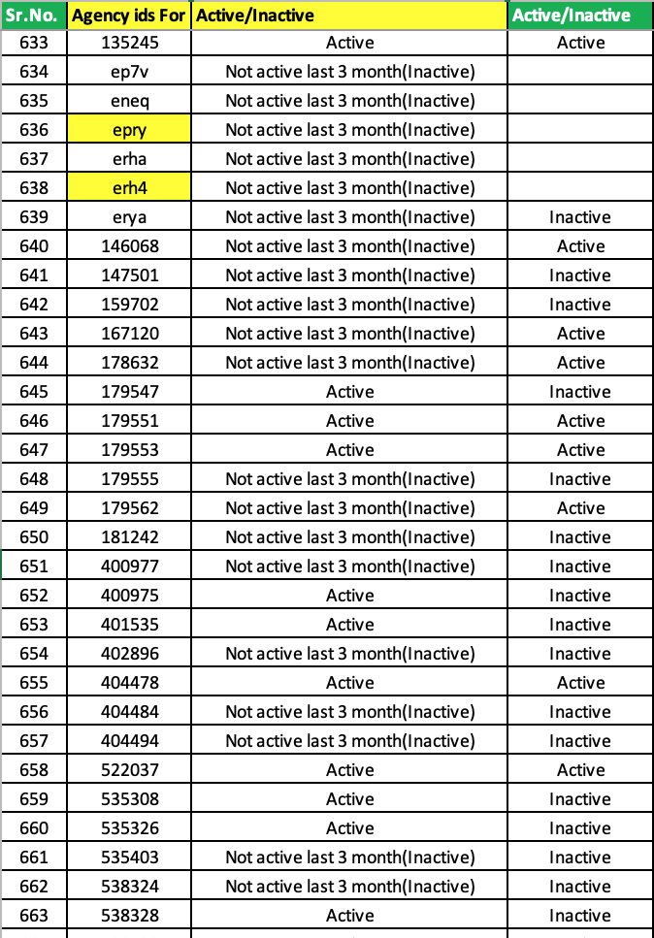
These still remain unstandardized
The process was very manual and different each time, and this continues to be the case in the PPSA records
For example, we can identify 578 formal providers who are networked in one of the programs, but then when we ask who is active, we have two conflicting answers in the same database

Slide 46
Recap
QuTUB Project Primary Aim: To attempt to assess whether PPIA projects improved quality of TB care.
Main takeaway 1: We can say the following with confidence:
In both cities, the program increased GeneXpert (GX) use among formal providers
In both cities, the program never has an impact on use of unnecessary medicines or other services
In Mumbai, the learning about GX due to program involvement improves GX use, but once providers have learned, convenience services from the program do not matter for doctors
In Mumbai, the program did not have any effect on AYUSH providers
Main takeaway 2: Despite the largest and most comprehensive SP study ever – ground complications, intervention design, and poor data management strategies limit our ability to draw definitive conclusions.
Main takeaway 3: The parameters that we are seeking to identify are also key inputs into any modelling exercise. Given the problems in #1, they cannot be clearly pinpointed right now. If we are to say something more definitive in the future, we need to learn from this attempt and make several changes that we discuss.

Slide 47
Acknowledgements
QuTUB and ISERDD:
Jishnu Das
Madhukar Pai
Ada Kwan
Ben Daniels
Veena Das
Ranen Das
ISERDD
Srinath Satyanarayana
Ramnath Subbaraman
Vaibhav Saria
Andrew McDowell
Caroline Vadnais
Sofi Bergkvist & ACCESS Health International
Pratyaksh Interactive Solutions Pvt. Ltd.
Others:
PATH team
WHP team
Technical Advisory Group
Puneet Dewan
Peter Small
Sameer Kumta & Kayla Laserson
MCGM (Daksha Shah)

Slide 48
Afternoon Session: Proposed Next Steps Lessons for monitoring and evaluation
Field Notes from The qutub project’s Research Project and products

Slide 49
Current state of play
Program design, field complications, and field-oriented data management make it challenging and cumbersome to definitively attribute improvements to the program
In addition, aspects of the program that are very costly may be the least important (convenience services vs learning effects)
The parameters that we are able to causally attribute to the program may be substantially smaller than what are being used for epidemiological modelling
An MLE consortium with a central steering group and a range of partners is a great idea – but what can we do better?
We’ve learned a lot about what the gaps in knowledge and measurement are, but building routine data collection at scale that fills these gaps is a big lift.

Slide 50
Standardized data management strategies across the PPSAs
Continuous analysis of routinely collected secondary data and primary studies/new data collection will require standards agreed upon and adopted by all PPSAs.
This needs an approach to all current routine data that works across cities
This also needs a new extension into types of data that are not currently collected
Needs to have a focus on high-quality inputs so that extensive cleaning is not needed
Rolling out the data system for this should not be immediately scaled to all areas, but should focus on being developed in some of the 9 priority states and repeated after 3-5 years to monitor trends.

Slide 51
Much better “triangulation” to fill in information on missing patients
Main shortcoming with monitoring data is that we have information on only providers who are engaged and the patients they choose to enroll
This makes behavior change relative to others hard to calculate, even if patient selection effects are strongly discounted
We cannot say how the behavior of the non-engaged providers differs from those of the engaged without triangulation
Current triangulation is done using SPs and drug sales data
Need to add in lab data with ordering doctor IDs, especially for services that are obtained from specialist labs (LPA, GX, DST), to get a more complete picture
This is a challenging manual process now, but once we understand how existing systems work, we can develop one that accommodates them.

Slide 52
Serious effort needed to improve utility of administrative data
Using eNikshay data for operational decision making and patient tracing was difficult, if not impossible: it was too messy for any retrospective analysis
Our experience in building similar systems (for instance, the RSBY platforms) is that we have to start with what exists, and make sure that it evolves to a common platform that everyone can use.
Once basic data is flowing smoothly, we need to start improving the quality of the input data.
This calls for a two-step process, where first, the platform is built and then specific QI strategies are implemented that improve the quality of the data. High-quality data input is an iterative challenge to resolve issues that are making the data hard to use on the back-end.
This requires not only a lot of upfront investment, but also buy-in and willingness to work with many teams on the structure of data as an essential ongoing component of the upcoming work program, not as a one-off task.

Slide 53
Use SPs for targeted A/B testing to resolve program and data questions
We strongly feel that the biggest impact of the PPE is that it leads to behavior change, and a key issue is how those results are mirrored in admin and routine data.
SPs in the pilot phase have shown robustly that they can be used for quality surveillance, but a “routine” SP program is not well-powered to answer specific questions about either performance or administrative data quality
We have now understood how to design targeted A/B experiments with SPs:
For instance, if we see that more patients are being asked to take a GX, but the routinely monitored lab data is not showing greater GX use, we can can undertake a narrowly tailored root-cause analysis to see why this is so and change data systems depending on the finding.
This way, we don't land up 3-5 years down the line without the necessary triangulated data to make clear statements, since we are constantly auditing data quality and program functioning with SPs.
It would be a shame if the program had large effects, but we were not able to detect them because they did not find their way into the data correctly. SPs can help both measure program effects directly, and to calibrate data systems, if they are carefully targeted.

Slide 54
Qutub project team support
We want to help to make sure that this does not happen--and love the idea of an MLE consortium with a primary studies section in a small number of priority settings that are used to adaptively improve the program and the data systems.
We propose two ways to do this:
Light touch
Receive data produced across all teams and provide initial assessments of data quality
Assess program performance when data is appropriate; flag datasets that are not usable or informative
Conduct targeted SP studies to evaluate specific program components or to audit data system quality
Heavy lift
Lead a team of M&E officers in each city with primary mission of making routine administrative data usable and informative – this will involve hiring and contracting M&E officers for each location under Qutub management
Conduct routine SP interactions for A/B testing of data system improvement strategy and course-correction
Coordinate across other research teams to produce useful results that triangulate on various data sources
Conduct targeted SP studies to evaluate specific program components or to audit data system quality

Slide 55
Acknowledgements
QuTUB and ISERDD:
Jishnu Das
Madhukar Pai
Ada Kwan
Ben Daniels
Veena Das
Ranen Das
ISERDD
Srinath Satyanarayana
Ramnath Subbaraman
Vaibhav Saria
Andrew McDowell
Caroline Vadnais
Sofi Bergkvist & ACCESS Health International
Pratyaksh Interactive Solutions Pvt. Ltd.
Others:
PATH team
WHP team
Technical Advisory Group
Puneet Dewan
Peter Small
Sameer Kumta & Kayla Laserson
MCGM (Daksha Shah)

Slide 56
Thank you!
The QUTUB Project Team

